Slide 1
ExtremeValues of Functions of Several Variables

Slide 2
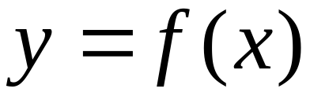




Recall
Functions of one-variable
Inflection point
Local Max
Neither
Local Min.
Stationary point
非驻点

Slide 3
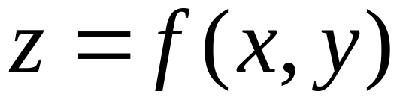
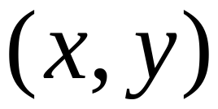
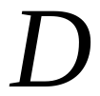

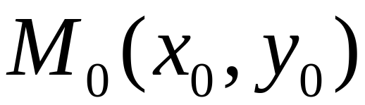
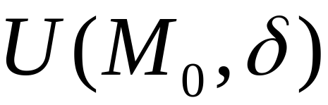

Functions of two variables
Domain
（M₀ interior point in D )

Slide 4

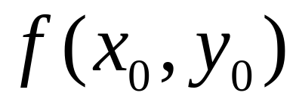
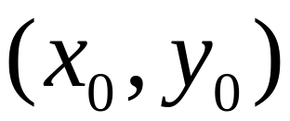
Local minimum, also global minimum

Slide 5
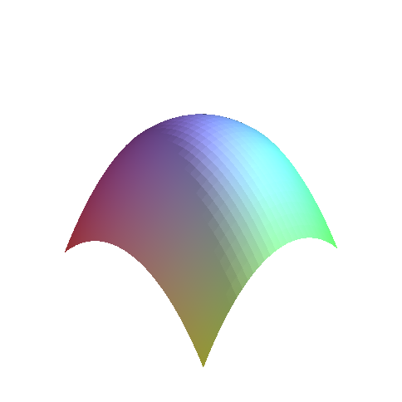
local maximum/also global maximum

Slide 6
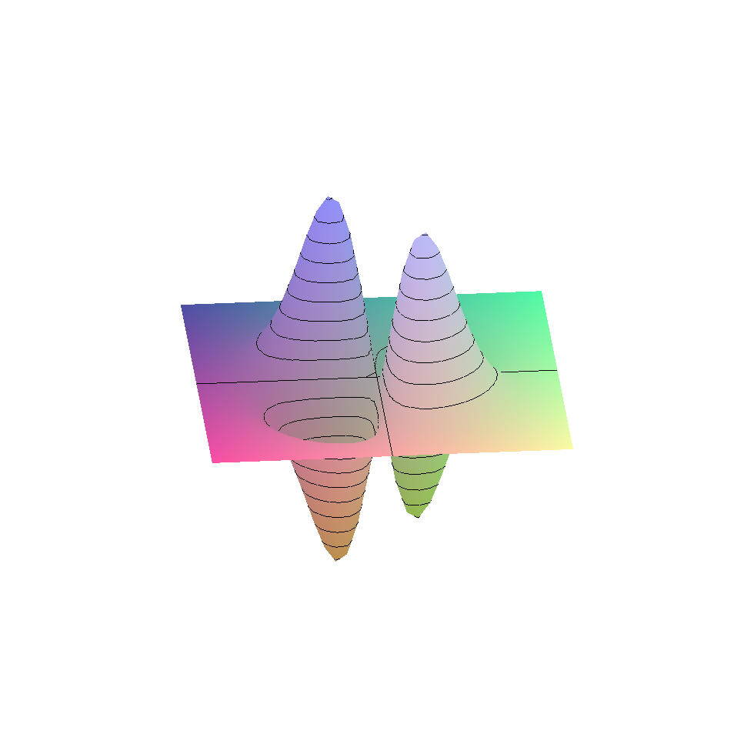
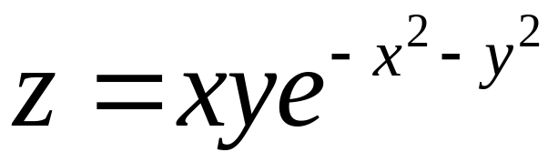
Local max
Local min

Slide 7
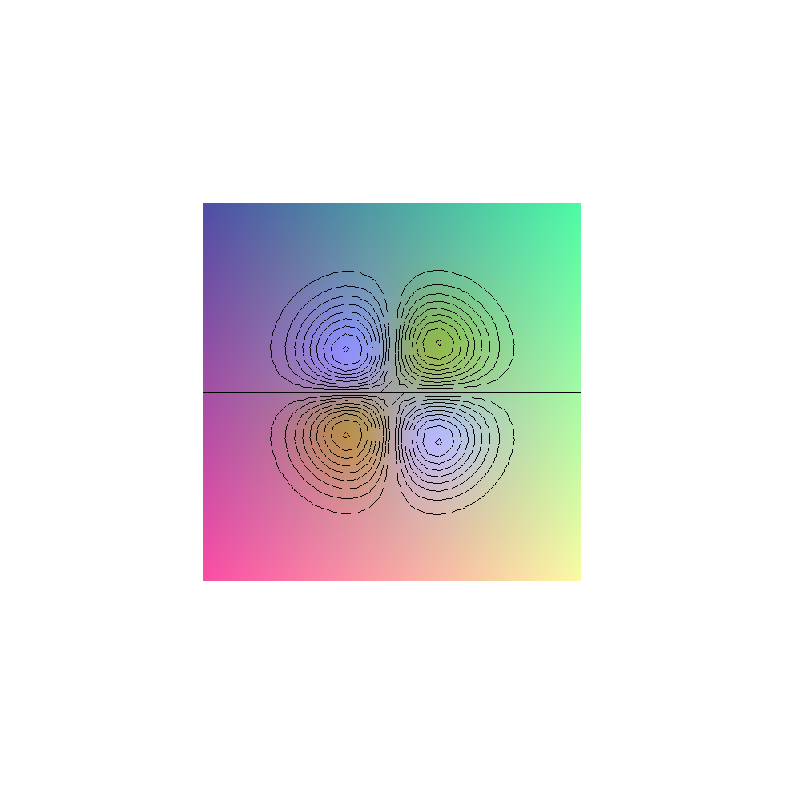
Local max
Local min
Local min
Local max

Slide 8
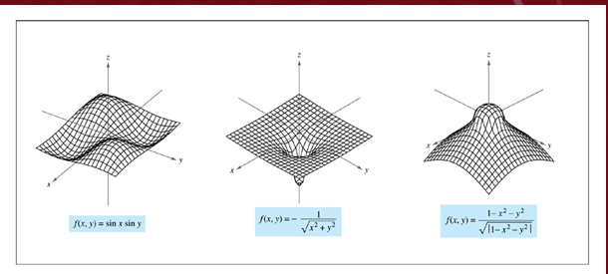
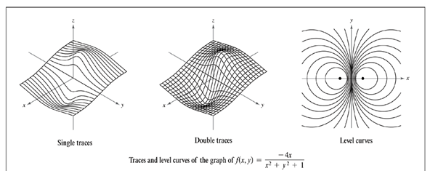

Slide 9
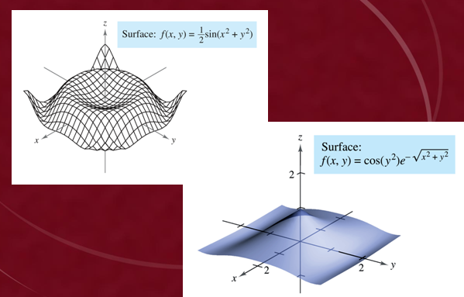

Slide 10
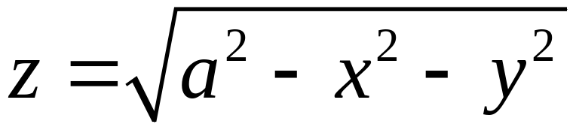
Global max
Also local maximum
Global minimum
Not local mini

Slide 11
How to Find ?
Necessary condition

Slide 12
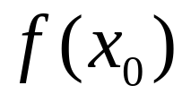
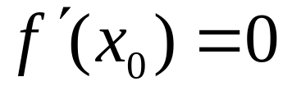
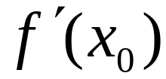
Recall
A necessary condition
is a local extremum，
The or does not exist

Slide 13
For Function of two variables?

Slide 14
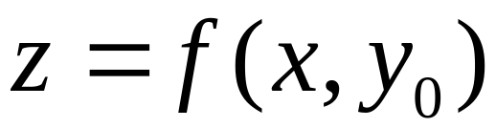
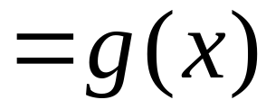
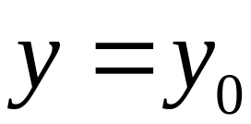

Slide 15


Slide 16
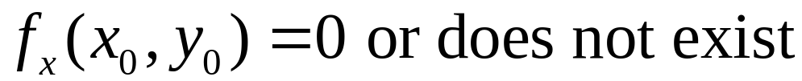
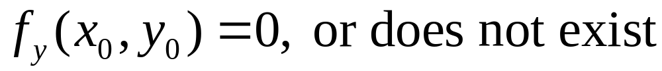
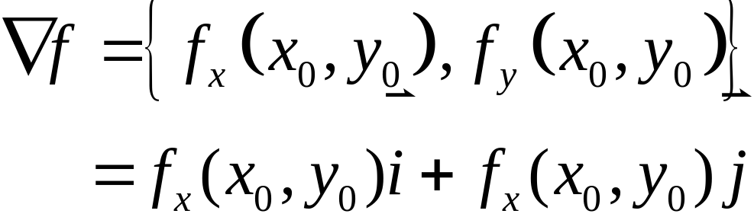
For Function of two variables
If
attains its local extremum at
Then
The gradient there is 0 or does not exist

Slide 17
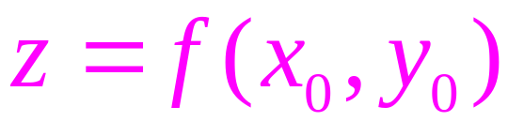
Geometric interpretation

Slide 18
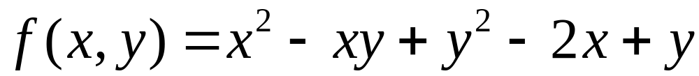
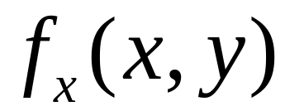




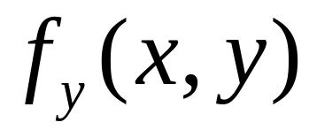
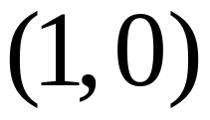

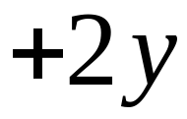

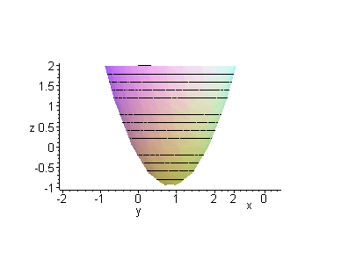
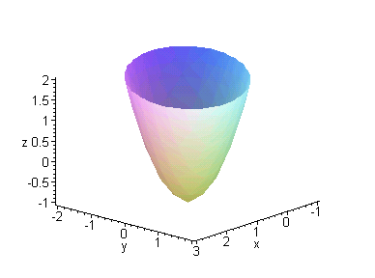
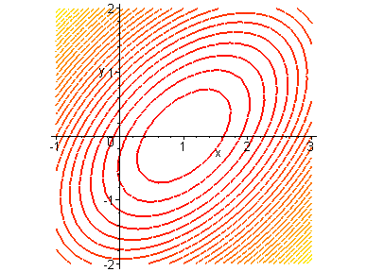
Example: Find candidate points of extreme points
Solution
Stationary point

Slide 19
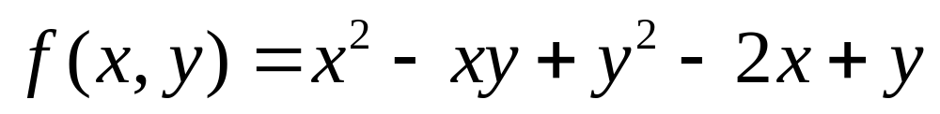
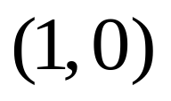
在点(1,0)处取得极小值－1
看上去这是一个椭圆抛物面
极小值点
with(plots):
x_axis:=plot3d([u,0,0],u=0..3,v=0..0.01,thickness=2):
y_axis:=plot3d([0,u,0],u=0..3,v=0..0.01,thickness=2):
z_axis:=plot3d([0,0,u],u=0..3,v=0..0.01,thickness=2):
qumian:=implicitplot3d({z=x^2-x*y+y^2-2*x+y},x=-2..3,y=-2..2,z=-2..2,scaling=constrained,style=patchcontour,numpoints=10000,contours=20):
display(qumian,x_axis,y_axis,z_axis,orientation=[40,70]);
contourplot(x^2-x*y+y^2-2*x+y,x=-1..3,y=-2..2,contours=30,thickness=2);

Slide 20
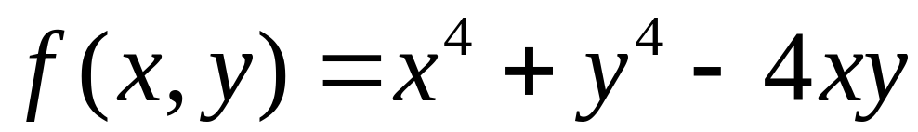
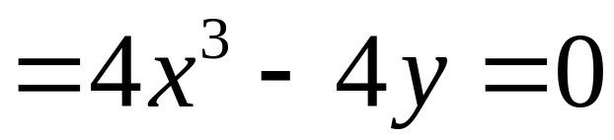
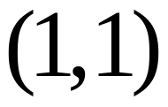
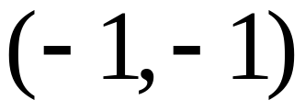
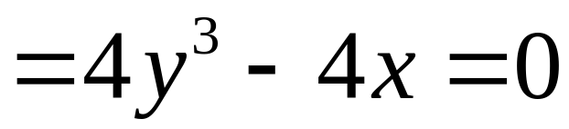
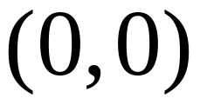
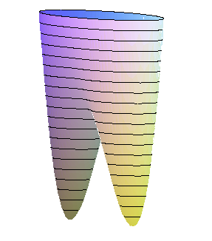
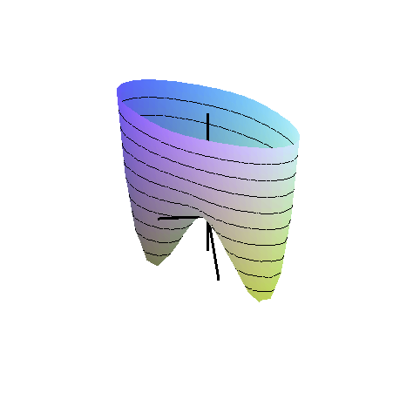
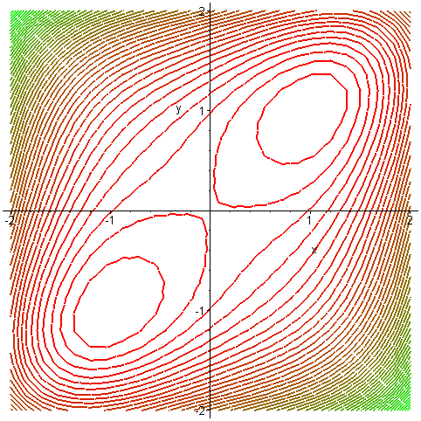
Example: Find candidate points of extreme points
Solution
Stationary points

Slide 21
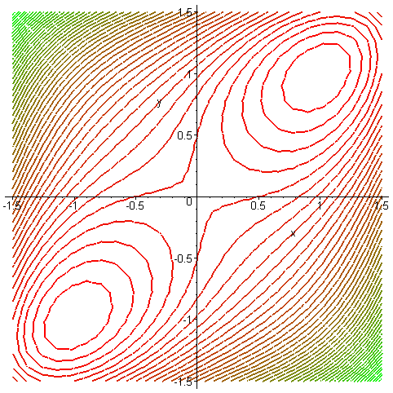
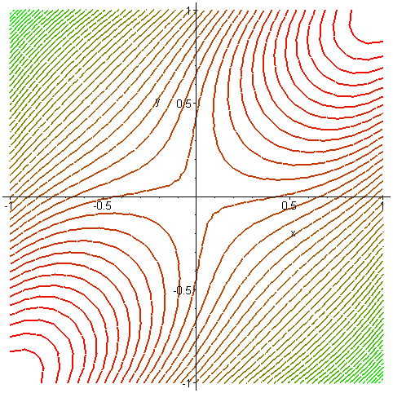
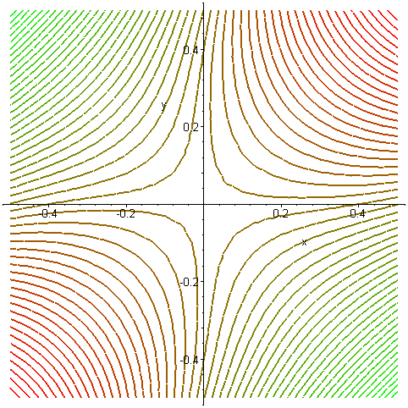
Saddle point
with(plots):
contourplot(x^4+y^4-4*x*y,x=-1..1,y=-1..1,thickness=2,contours=50,coloring=[red,green]);

Slide 22
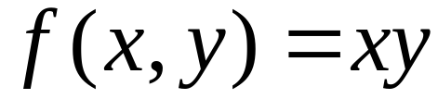



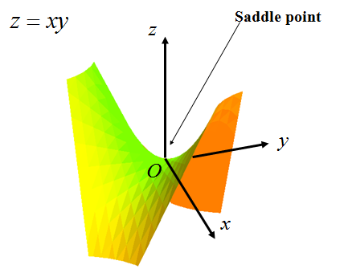

Eample: Find candidate points of extreme points
Solution
Stationary point

Slide 23


Critical point
The partial derivative does not exist, so the gradient does not exist at (0, 0), but …

Slide 24
We now know how to find candidates for possible local extrema, but how to determine the nature of a candidate: whether or not it is a local maximum, local minimum or neither.

Slide 25















A sufficient condition: second derivative test
If
is a stationary point：
And
then
is a local extremum
Local minimum
Local maximum
Saddle point, not local extremum
inconclusive

Slide 26











Example: Find local Extrema
Solution：
Find critical points first
Stationary point
So there is a local extremum
and
so
Local minimum

Slide 27
Attains a local minimum at (1,0)
with(plots):
x_axis:=plot3d([u,0,0],u=0..3,v=0..0.01,thickness=2):
y_axis:=plot3d([0,u,0],u=0..3,v=0..0.01,thickness=2):
z_axis:=plot3d([0,0,u],u=0..3,v=0..0.01,thickness=2):
qumian:=implicitplot3d({z=x^2-x*y+y^2-2*x+y},x=-2..3,y=-2..2,z=-2..2,scaling=constrained,style=patchcontour,numpoints=10000,contours=20):
display(qumian,x_axis,y_axis,z_axis,orientation=[40,70]);
contourplot(x^2-x*y+y^2-2*x+y,x=-1..3,y=-2..2,contours=30,thickness=2);

Slide 28



Example: Find local Extrema
Solution：
Find critical points first
Stationary
points

Slide 29










Stationary points
no
yes
and
so
Local minimum
Similarly,
also local minimum

Slide 30
with(plots):
qumian:=implicitplot3d(z=x^4+y^4-4*x*y,x=-2..2,y=-2..2,z=-2..3,numpoints=5000,style=patchcontour):
x_axis:=plot3d([u,0,0],u=-1..3,v=0..0.01,thickness=3):
y_axis:=plot3d([0,u,0],u=-1..1.5,v=0..0.01,thickness=3):
z_axis:=plot3d([0,0,u],u=-1..3,v=0..0.01,thickness=3):
display(qumian,x_axis,y_axis,z_axis,orientation=[-28,45]);

Slide 31
Saddle point
with(plots):
contourplot(x^4+y^4-4*x*y,x=-1..1,y=-1..1,thickness=2,contours=50,coloring=[red,green]);

Slide 32

Exercise:
Find all the local maxima, local minima, and saddle points of the function

Slide 33


Exercise:
Find all the local maxima, local minima, and saddle points of the function
Answer:
local maxima
saddle points

Slide 34
END

